Slide 1
Operating System Implications of
Fast, Cheap, Non-Volatile Memory
Zonghua Gu

Slide 2
Memory Hierarchy
DRAM is volatile: content is lost upon power down
Disk is non-volatile: content is persistent even if power down
Fast
Dense, cheap
Byte-addressable
Volatile
High refresh power
Slow
Denser, cheaper Sector-oriented
Persistent
Lower power

Slide 3
Non-Volatile Memory, NVM
Includes Flash, PCM (Phase-Change Memory), STT-RAM (Spin-transfer Torque RAM), MRAM…
NVM
Fast
Dense, cheap
Byte addressable
Persistent
Lower power

Slide 4
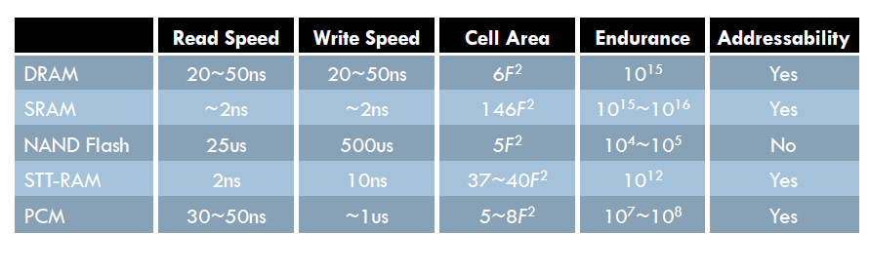
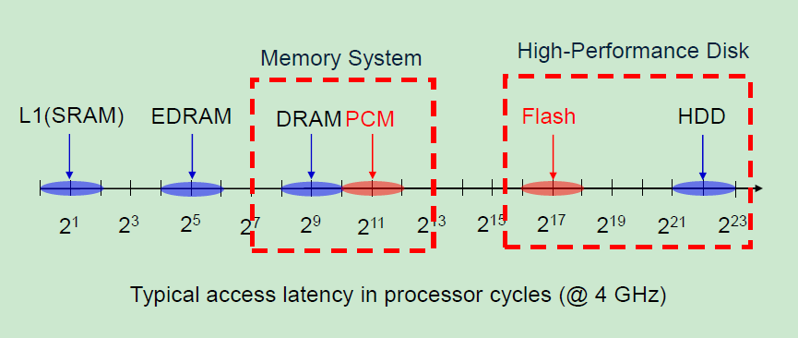
Performance Comparison between NVM Technologies

Slide 5
NVM Pros and Cons
Pros:
  Data are not lost upon power loss (hence the name “non-volatile”
  Power efficient, no leakage power (like DRAM)
  Each cell can store multiple bits → higher storage density
  Higher reliability, much lower chance of transient faults compared to DRAM
Cons:
  Write operation is much slower than read
  Writes cause wearout, chip lifetime is limited by writes
Notes:
可以达到2bits/cell

Slide 6
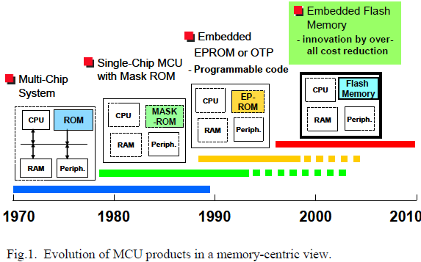
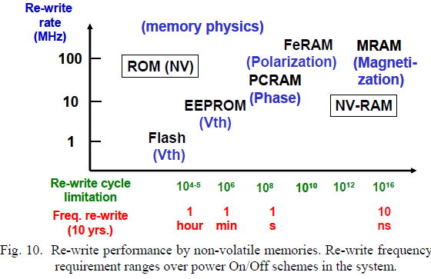
NVM in Auto Electronics
Data come from Renesas, an automotive ECU vendor
  Shows increasing importance of NVM in ECUs
  Currently mainly use Flash, but PCM and other novel NVMs are upcoming

Slide 7
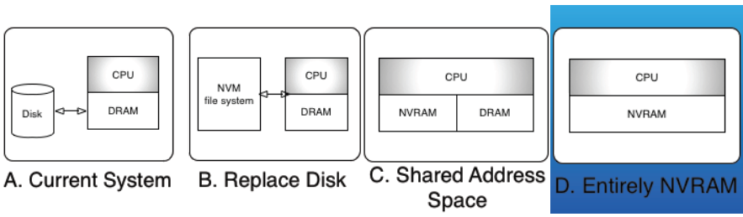
Config Alternatives
Let’s focus on D: entirely NVRAM
The most extreme option offers the widest array of research and design opportunities

Slide 8
Deep Implications for OS Design
NVRAM technology might change the basic premise of a two-level store (a fast primary memory and a slow secondary memory) that we have assumed for over 50 years.
  What if future systems contained only one level of memory that was persistent and uniform?
  What if there were no disk pages, no memory pages, no buffer cache, no page faults, no swapping, no booting on restart?
  How would we choose to organize the OS and persistent storage?
  How would we structure, share, and protect persistent storage?
  What parts of the OS could we simplify or remove, and what features or capabilities would be enabled by this technology?

Slide 9
Virtual Memory
Virtual memory is a bridge between main memory and storage. With a single level, this bridge is no longer needed.
Paging
  VM systems treat primary memory as a fast cache of secondary storage, paging data between these two levels.
  A computer with only NVRAM has one level of physical storage, not two, and no longer needs to page.
Page granularity
  Page size is influenced by many factors, including minimizing fragmentation, amortizing the latency of disk seeks, and minimizing the overhead of page table structures.
  In an NVM-based computer, many of the factors above will change or be eliminated, so may have different page granularity, or even not be page-based.
Notes:
Swapping is clearly not needed, but we still need naming and protection

Slide 10
Virtual Memory Cont’
Separate protection systems for primary and secondary storage.
  Virtual memory provides hardware-enforced page-granularity protection, whereas file systems have a richer but coarser protection structure.
  In an NVRAM-based computer, both protection systems might need to be reconsidered and maybe unified.
Multiple address spaces.
  Today’s VM systems provide separate address spaces for each process, whereas file systems expose a single global namespace.
  Given that an NVRAM-based computer has a single, fast, large-capacity store, alternative structures such as single-address-space OS might be more appropriate
    [5] Jeffrey S. Chase, Henry M. Levy, Michael J. Feeley, and Edward D. Lazowska. Sharing and protection in a single address-space operating system. ACM Transactions on Computer Systems, 12(4), 1994
Notes:
Since there is only one level of
storage, hardware-enforced protection and the
protection abstractions the OS provides will likely
need to reflect each other more closely, and perhaps
they can even be unified.

Slide 11
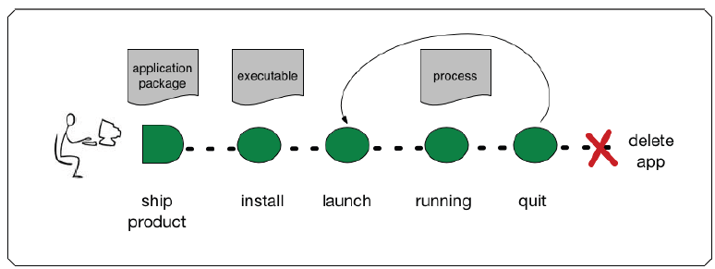
Current Process Model
Today, applications exist in three different forms:
  packaged state prior to installation,
  post-installed state in the file system,
  execution state when launched into processes.
NVM has the potential to blur the boundaries between these,

Slide 12
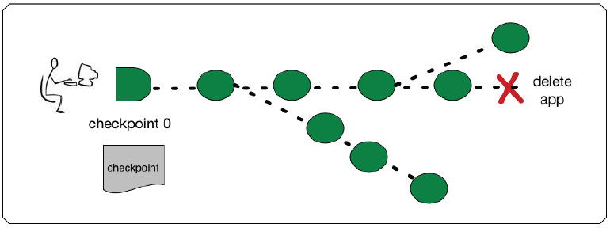
New Process Model
Applications could ship as checkpoints of an executing process
  Can we checkpoint at anytime?
Instead of distinguishing between inactive applications and active processes, every application that is resident on a local computer could be perpetually “active,” since its execution state is durable and, in effect, is a checkpoint for the process.
The concept of launch would no longer need to be exposed to users, and instead applications are scheduled whenever some form of input (user, device, or other event) is directed towards them.
Notes:
assuming
that the checkpoint can be taken at a “convenient”
moment where there are as few dependencies as
possible in the underlying OS, such as outstanding system
calls

Slide 13
Reliability Built on Persistence
Every piece of data is now persistent, increasing reliability.
But → Every piece of data in the stack and heap is persistent whether consistent or not.
  But what if there are bugs?
  Where is it safe to roll back to?
  How does corruption show up?
  What are the consistency guarantees?

Slide 14
Conclusion
Non-volatile main memory affects nearly every area of OS design:
  virtual memory, file systems, processes, reliability, security, etc.
Many questions to be answered
Many opportunities for new designs
We don’t know what the “right” answer is

Slide 15
相关工作
Flash内存技术较为成熟，很多相关论文；Flash相关工作有一定参考价值
新型NVM(PCM为代表）出现较晚，论文较少；其与Flash相比有很多相似与不同点
  相似：
    都是非易失内存(NVM)
    写操作有较高开销
  不同：
    运行速度与可靠性均有大幅提高
    Flash通常用于取代硬盘作为存储媒介, 而PCM可用于主存，甚至缓存

Slide 16
两种混合存储架构
Processor Core
Processor Core
L2 Cache (SRAM)
L2 Cache (SRAM)
DRAM cache
PCM-based main memory (PRAM)
DRAM
PRAM
flash memory
disk cache
flash memory
disk cache
hard disk drive
hard disk drive
DRAM作为缓存
PRAM作为主存
DRAM与PRAM并列作为主存
Notes:
The figure shows one projection of future memory hierarchy.
processors use SRAM on-chip for its highest performance, while next DRAM cache is used. Next is PCM-based main memory for its high performance and low cost
Flash memory is used as cache for the slowest hard disk drive

Slide 17
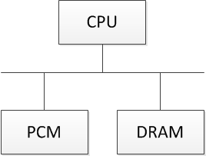
系统架构
目前我们考虑并列架构
内存分配问题
  指令内存应当放在PCM （只读不写，避免PCM写操作相关缺陷）
  数据内存需要在PCM与DRAM之间作（静态或动态）分配
Notes:
（可以有多种内存材料，只要其中有PCM即可）。
PCM与DRAM结合的混合内存架构
将数据分配在不同内存中以实现最小能量消耗，分配可以是动态的也可以是静态的。

Slide 18
考虑因素
当我们需要将数据放入到PCM或者DRAM中的时候，我们需要考虑的问题有：
  这个操作会影响系统的调度性或者程序性能吗
  这个操作会减少系统的能量消耗吗
  这个操作会影响PCM的耐久性吗
  ……
我们需要兼顾上面的这些因素，所以有时候需要在这些因素中做一个trade-off，以得到最佳结果。

Slide 19
数据分配
根据各种内存的特征，将数据分配在最合适的内存上（比如，有些写操作比较频繁的数据适合放在DRAM上，而不是PCM上）以实现最小功耗。
静态分配
  可以依靠程序在编译阶段的信息来判断将哪些数据分配在哪种内存上，以达到最节能的效果。可以使用ILP工具进行计算。
动态分配
  在程序运行的时候，根据数据的读写情况来判断将数据分配在哪种内存上。
优化算法
  整数线性规划（ILP），模拟退火，遗传算法，启发式算法…

Slide 20
其他方法
除了数据分配的方法外，还有下列方法：
  当内存的读取速度和CPU的运行速度不匹配的时候，可以通过DVS的方法来调节CPU的运行速度，这样也可以减少CPU消耗的电量。
  当内存请求比较少的情况下，可以降低内存控制器的电压，这样不会影响程序的性能，并且能够达到节能的效果。

Slide 21
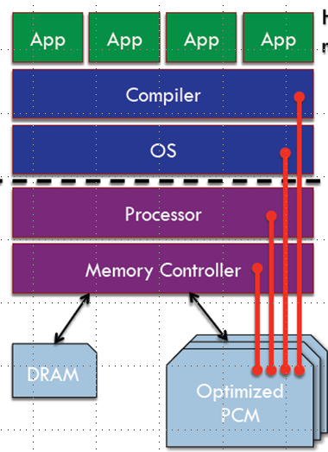
研究思路
现在我们考虑的模型比较简单，在将来，我们可以加入更多的因素到模型中。比如：可靠性，多核，电压调节技术，等
现在，我们考虑的层次主要集中在内存控制器这一层，以后我们也可以扩展到编译器，OS或者处理器硬件层面

Slide 22
嵌入式系统可靠性问题
随着半导体尺寸的日益缩小，硬件的错误率也日益严重
  瞬态错误
    例如空间粒子导致的SEU（Single-Event Upset)与比特位反转(bit-flip)，
    在航空与汽车控制领域的恶劣环境下尤其严重
  永久性错误
    例如电子器件老化导致的硬件失效
需要在多个层面提高系统可靠性
  硬件，操作系统，应用

Slide 23
系统可靠性优化
PCM可靠性较高，基本没有瞬态错误问题
研究思路：
  将重要数据放在PCM中，以提高其可靠性
  结合处理器的动态电压频率调节(DVFS)技术来同时降低功耗
    由于PCM写操作较为耗时，在PCM IO阶段降低处理器电压
    为了满足实时性，在非PCM IO阶段提高处理器电压
  实现方法：编译器阶段插入DVFS指令
Compute
Compute
Compute
处理器
电压
PCM IO
PCM IO
时间

Slide 24
远期研究方向
借鉴现有Flash与DRAM领域相关工作，并考虑PCM特性来改进现有算法
将PCM作为缓存（而不是主存）来进一步提高性能与可靠性
探讨除PCM以外的各种NVM在汽车电子中的适用性

Slide 25
国际合作
与香港理工大学副教授邵子立合作
  是非易失存储与实时系统领域的主要专家之一
  以前主要做FLASH存储，去年开始关注PCM在实时系统领域应用，认为这是新兴热点
每1-2周召开电话会议讨论进展

Slide 26
论文发表情况
投稿一篇
  Power-Aware Task Partitioning for DSPs with Hybrid PCM and DRAM Main memory
  IEEE Embedded Systems Letters
已发表一篇会议论文 （车载虚拟化平台相关）
  Zonghua Gu, Zhu Wang, Shijian Li, Haibin Cai: Design and Implementation of an Automotive Telematics Gateway Based on Virtualization. ISORC Workshops 2012: 53-58

Slide 27
Backup

Slide 28
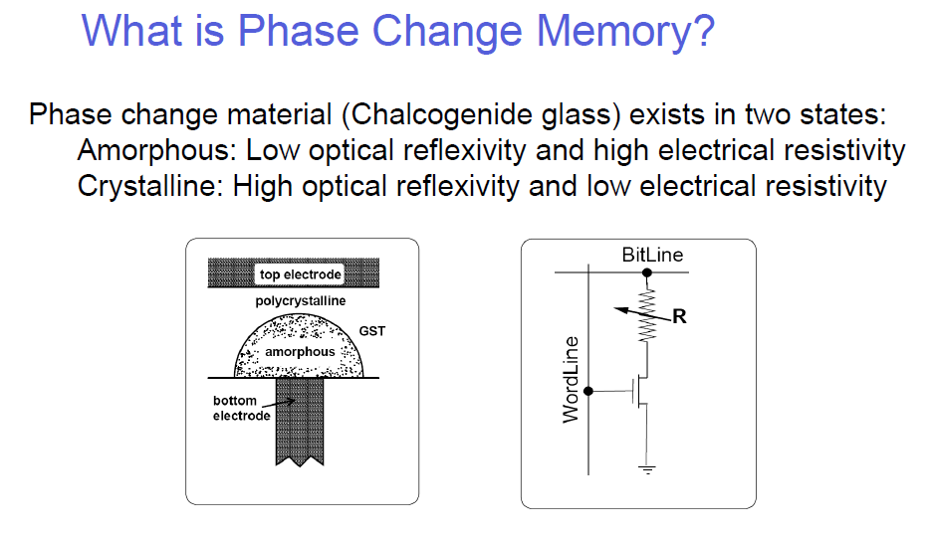
Phase Change Memory（PCM）

Slide 29
PCM：高性能，低功耗的新型内存
cost
SRAM
DRAM
flash memory
PCM
Hard Disk Drive
Performance
Geoffrey W. Burr, IBM, Non-volatile Memories Workshop 2010
Notes:
Phase Change Memory (PCM)
A New Emerging Memory Technology
PCM is a very appealing memory technology
This Figure shows the comparison of PCM with other memory technologies in terms of performance and cost
First, for SRAM it shows the highest performance while incurs highest cost.
In comparison, DRAM lowers the cost while suffer performance loss
The performance of Flash memory is much lower than DRAM while it achieves lower cost
Hard disk drive is of the lowest performance and lowest cost.
Compared to flash memory, PCM has lower cost and achieve much better performance. In fact, the performance is even close
To DRAM. Therefore it is very attractive for being used in main memory

Slide 30
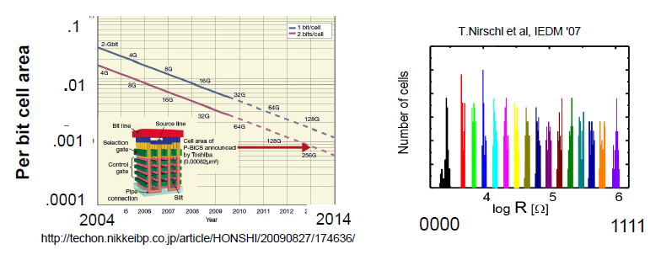
PCM的主要优点
扩展性比DRAM更好，cell的尺寸更小
  可以达到3nm╳20nm的尺寸
一个cell能够存储多个bit->在同样的区域上有更大的密度
  可以达到2bits/cell
非易失性 (Non-Volatile)
  在断电的情况下依然能够保持数据
Notes:
，可靠性也较好

Slide 31
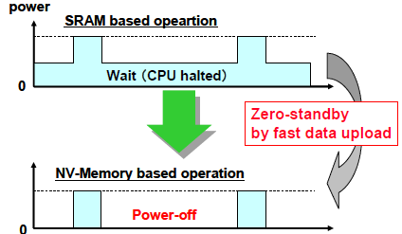
Evolution of Embedded Flash Memory Technology for MCU
Hideto Hidaka

Slide 32
